Slide 1
Logical Architecture

Slide 2
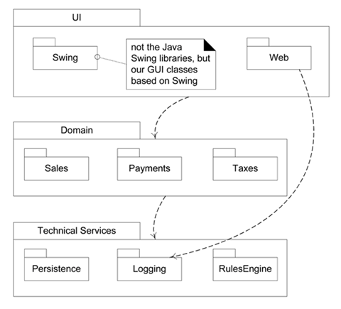

Slide 3
Layers in an OO System
User Interface.
Application Logic and Domain Objects
Technical Services

Slide 4
Using layers helps address several problems:
Source code changes are rippling throughout the systemmany parts of the systems are highly coupled.
Application logic is intertwined with the user interface, so it cannot be reused with a different interface or distributed to another processing node.
Potentially general technical services or business logic is intertwined with more application-specific logic, so it cannot be reused, distributed to another node, or easily replaced with a different implementation.
There is high coupling across different areas of concern. It is thus difficult to divide the work along clear boundaries for different developers.

Slide 5
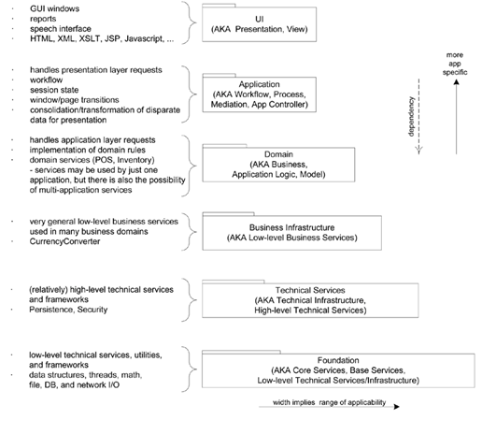
Common layers in an information system logical architecture

Slide 6
Benefits of Using Layers
This reduces coupling and dependencies, improves cohesion, increases reuse potential, and increases clarity.
Related complexity is encapsulated and decomposable.
Some layers can be replaced with new implementations. This is generally not possible for lower-level Technical Service or Foundation layers (e.g., java.util), but may be possible for UI, Application, and Domain layers.
Lower layers contain reusable functions.
Some layers (primarily the Domain and Technical Services) can be distributed.
Development by teams is aided because of the logical segmentation.

Slide 7
// --- UI Layer
com.mycompany.nextgen.ui.swing com.mycompany.nextgen.ui.web
// --- DOMAIN Layer
com.mycompany.nextgen.domain.sales com.mycompany.nextgen.domain.payments
// --- TECHNICAL SERVICES Layer com.mycompany.service.persistence
  // third party
  org.apache.log4j org.apache.soap.rpc
// --- FOUNDATION Layer
com.mycompany.util

Slide 8
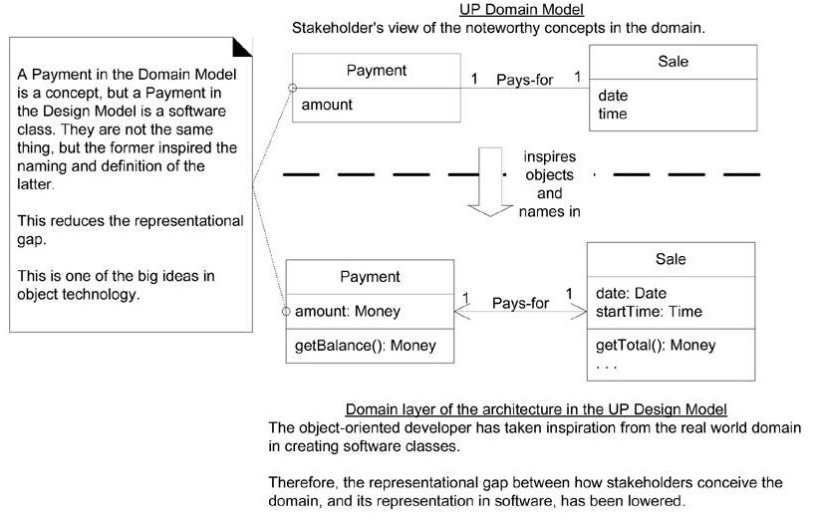
Domain layer and domain model

Slide 9
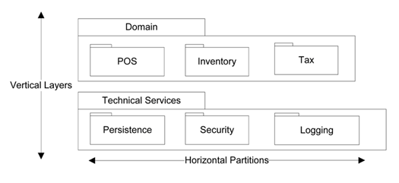
Layers and Partitions

Slide 10
The Model-View Separation Principle
Do not connect or couple non-UI objects directly to UI objects. For example, don't let a Sale software object (a non-UI "domain" object) have a reference to a Java Swing JFrame window object.
Do not put application logic (such as a tax calculation) in the UI object methods. UI objects should only initialize UI elements, receive UI events (such as a mouse click on a button), and delegate requests for application logic on to non-UI objects (such as domain objects).

Slide 11
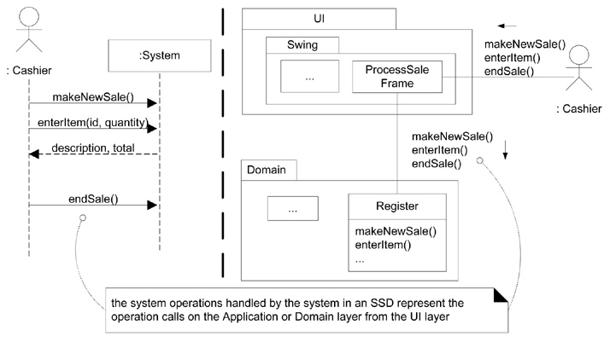
System operations in the SSDs and in terms of layers

Slide 12
NextGen Logical Architecture

